Slide 1



Income Predictor
Alberto Torres

Slide 2
Decisions
Crossroad about going to college.
Is the income after college worth it?
Predicting model to forecast annual income for individuals with a college education.

Slide 3


College Enrollment Rate downfall
Nearly one million less students enrolled in college in 2022 then before 2020.
From 2019-2021 colleges seen undergraduate student enrollment fall by 6.6%.
Biggest decline in more than 50 years.
Americans choose jobs over college : NPR

Slide 4
Short-term benefits vs. long-term benefits of a degree.
According to Georgetown University, bachelor's degree holders were found to "earn a median of $2.8 million during their career, 75% more than if they had only a high school diploma."
Many high school students go for short-term money rather than a long-term career and high wages.

Slide 5
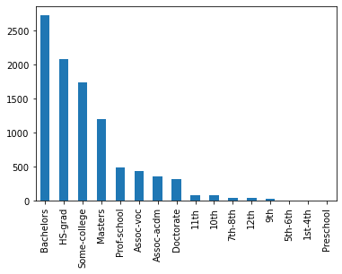
Data understanding
Individuals who make more than 50K a year
Machine learning model:
Visually demonstrate who is making more money annually.
Predictor takes in attributes such as education, relationship, hours worked, etc.
In Dataset 9.6K/39.4K individuals made over 50K
Num of individuals

Slide 6
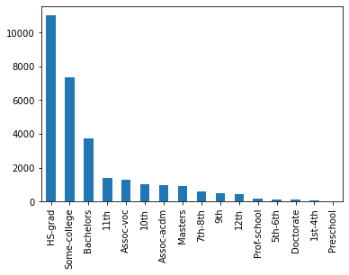
Data understanding Cont.
Individuals who make less than 50K a year
Georgetown University study, HS-Grads are the ones earning less than 50K a year.
There’s more than 50% HS-grads that make less than 50K then someone that has their bachelor's degree.
Num of individuals

Slide 7
Predictive model
Models
Decision Tree-
Model that branches connecting data point to produce a decision
Accuracy for this case is: 76.2%
Out of all individuals making over 50K how precise can it predict a decision: 81%
Random Forest-
Variables
Target Variable: Income >50K
Education: Highest level of education individual achieved
Occupation: Current work position
Race
Gender: Male or Female
Relationship: If individual is a husband, wife, single, etc.
Hours worked per week

Slide 8
Next Steps
Bigger dataset
Handle imbalanced dataset

Slide 9

Thank you

